Slide 1
Kingdom-class educators engaged in power educating
For the kingdom of God is not in word but in power.
(1 Corinthians 4:20 NKJV)

Slide 2
The Kingdom sought
But seek the kingdom of God, and all these things shall be added to you. “Do not fear, little flock, for it is your Father's good pleasure to give you the kingdom. (Luke 12:31 NKJV)
And I bestow upon you a kingdom, just as My Father bestowed one upon Me, (Luke 22:29 NKJV)

Slide 3
The Kingdom sought
The scepter will not depart from Judah, nor the ruler's staff from between his feet, until he comes to whom it belongs and the obedience of the nations is his. (Gen. 49:10 NIV)
“I have installed my King on Zion, my holy hill.” I will proclaim the decree of the LORD: He said to me, “You are my Son; today I have become your Father. Ask of me, and I will make the nations your inheritance,
the ends of the earth your possession. You will rule them with an iron scepter;” (Psalms 2:6-9 NIV)

Slide 4
The Kingdom sought
Psalms 24:1-10
Psalms 45:72, 89
Psalms 110:1-7
Isaiah 9:6-7
Isaiah 32:1
Jeremiah 23:5
Ezekiel 21:27
Daniel 7:13
Hosea 3:5
Micah 5:4
Zechariah 9:9
Zechariah 14:9
Not A Personal Savior
A National Deliverer

Slide 5
The Kingdom sought
Now when He was asked by the Pharisees when the kingdom of God would come, He answered them and said, “The kingdom of God does not come with observation; (Luke 17:20-21 NKJV)
And John, calling two of his disciples to him, sent them to Jesus, saying, “Are You the Coming One, or do we look for another?” (Luke 7:19 (NKJV)
Therefore, when they had come together, they asked Him, saying, “Lord, will You at this time restore the kingdom to Israel?” (Acts 1:6 NKJV)

Slide 6
The Kingdom sought
Then the devil, taking Him up on a high mountain, showed Him all the kingdoms of the world in a moment of time. And the devil said to Him, “All this authority I will give You, and their glory; for this has been delivered to me, and I give it to whomever I wish. (Luke 4:5 NKJV)
What did the devil show Jesus?

Slide 7
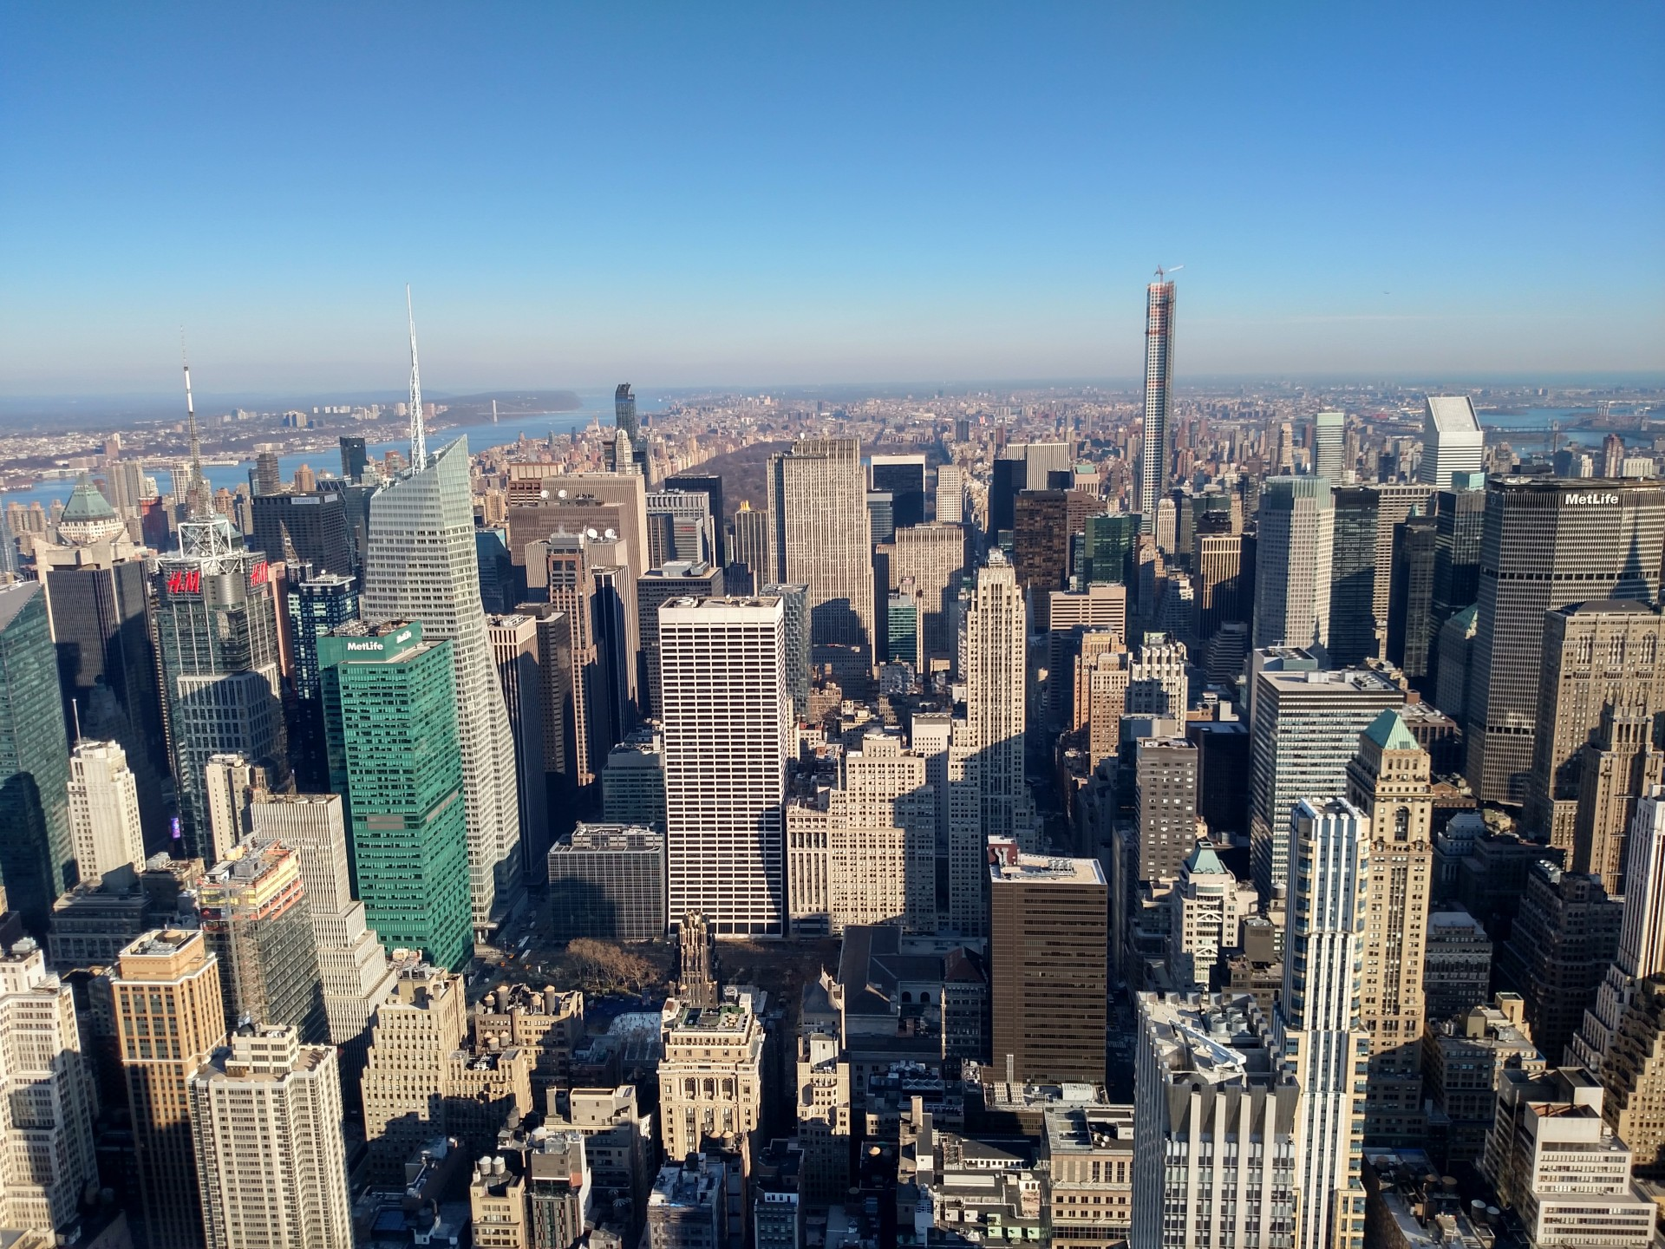

Slide 8
The Kingdom sought
Then the devil, taking Him up on a high mountain, showed Him all the kingdoms of the world in a moment of time. And the devil said to Him, “All this authority I will give You, and their glory; for this has been delivered to me, and I give it to whomever I wish. (Luke 4:5 NKJV)
authority
What did the devil show Jesus?

Slide 9
The Kingdom sought
Then he said to me, “Do not fear, Daniel, for from the first day that you set your heart to understand, and to humble yourself before your God, your words were heard; and I have come because of your words. “But the prince of the kingdom of Persia withstood me twenty-one days; and behold, Michael, one of the chief princes, came to help me, for I had been left alone there with the kings of Persia. (Daniel 10:12 NKJV)
prince of the kingdom of Persia

Slide 10
The Kingdom sought
Then he said, “Do you know why I have come to you? And now I must return to fight with the prince of Persia; and when I have gone forth, indeed the prince of Greece will come. (Daniel 10:20 (NKJV)
prince of Greece

Slide 11
The Kingdom sought
I will not speak with you much longer, for the prince of this world is coming. He has no hold on me, (John 14:30 NIV)
prince of this world
And you He made alive, who were dead in trespasses and sins, in which you once walked according to the course of this world, according to the prince of the power of the air, the spirit who now works in the sons of disobedience, (Ephesians 2:1 NKJV)
prince of the
power of the air

Slide 12
The Kingdom sought
Then the devil, taking Him up on a high mountain, showed Him all the kingdoms of the world in a moment of time. And the devil said to Him, “All this authority I will give You, and their glory; for this has been delivered to me, and I give it to whomever I wish. (Luke 4:5 NKJV)
authority
I give it to whomever
I wish

Slide 13
The Kingdom sought
authority
Exousia: Authority, Right, Liberty, Power to Do Something
We know that we are children of God, and that the whole world is under the control of the evil one.
(1 John 5:19 NIV)

Slide 14
The Kingdom sought
Of the World
On Earth
Subjects of The Kingdom of This World
Subject To The Ruler (Prince) of This World

Slide 15
The Kingdom sought
In Heaven
Of the World
Of the World
On Earth
Occupants of This World
Of the World
No Longer Subject To The Ruler of This World

Slide 16
The Kingdom sought
I will not speak with you much longer, for the prince of this world is coming. He has no hold on me, (John 14:30 NIV)
…for they are not of the world any more than I am of the world. (John 17:14 NIV)

Slide 17

The Kingdom sought
In Heaven
Of the World
Of the World
On Earth
In Heaven
On Earth
In Heaven
Of the World
On Earth
Of the World
On Earth
In Heaven
Of the World
Of the World
In Heaven
On Earth
Of the World
In Heaven
On Earth
Of the World
In Heaven
On Earth

Slide 18
The Kingdom sought
Now when He was asked by the Pharisees when the kingdom of God would come, He answered them and said, “The kingdom of God does not come with observation;
…For indeed, the Kingdom of God is within you. (Luke 17:20-21 NKJV)
But seek the kingdom of God, and all these things shall be added to you. “Do not fear, little flock, for it is your Father's good pleasure to give you the kingdom. (Luke 12:31 NKJV)

Slide 19
The Kingdom sought
SEEKING the KINGDOM
Searching for Something That is
Not Possessed or Hidden
Realizing Something That Is Already Possessed and Inherent

Slide 20
The Kingdom sought
And Jesus came and spoke to them, saying, “All authority has been given to Me in heaven and on earth. (Matthew 28:18 NKJV)
authority
But as many as received Him, to them He gave the right to become children of God, to those who believe in His name: who were born, not of blood, nor of the will of the flesh, nor of the will of man, but of God. (John 1:12 NKJV)

Slide 21
The Kingdom sought
And Jesus came and spoke to them, saying, “All authority has been given to Me in heaven and on earth. (Matthew 28:18 NKJV)
authority
But as many as received Him, to them He gave the authority to become children of God, to those who believe in His name: who were born, not of blood, nor of the will of the flesh, nor of the will of man, but of God. (John 1:12 NKJV)

Slide 22
The Kingdom sought
authority
Behold, I give you the authority to trample on serpents and scorpions, and over all the power of the enemy, and nothing shall by any means hurt you. (Luke 10:19 (NKJV)
“And I will give you the keys of the kingdom of heaven, and whatever you bind on earth will be bound in heaven, and whatever you loose on earth will be loosed in heaven.” (Matthew 16:19 NKJV)

Slide 23
The Kingdom sought
Jesus stated emphatically that the kingdom of God was not a matter of external observation but a matter of internal realization. It would be inherent within His people. It would not be outward institution-based but rather inward people-based.

Slide 24
The Kingdom sought
Do you not know that you are the temple of God and that the Spirit of God dwells in you? (1 Corinthians 3:16 NKJV)
Do you not know that your body is a temple of the Holy Spirit, who is in you, whom you have received from God? You are not your own; you were bought at a price. Therefore honor God with your body.
(1 Corinthians 6:19 NIV)

Slide 25
The Kingdom realized
But you are a chosen generation, a royal priesthood, a holy nation, His own special people, that you may proclaim the praises of Him who called you out of darkness into His marvelous light; (1 Peter 2:9 NKJV)
I am chosen
I am of royalty
I am set apart
I am special
For the sole purpose of reflecting Christ

Slide 26
The Kingdom realized
But you are a chosen generation, a royal priesthood, a holy nation, His own special people, that you may proclaim the praises of Him who called you out of darkness into His marvelous light; (1 Peter 2:9 NKJV)
I am chosen to be in this school with my students
I am of royalty
I am set apart
I am special
For the sole purpose of reflecting Christ

Slide 27
The Kingdom realized
But you are a chosen generation, a royal priesthood, a holy nation, His own special people, that you may proclaim the praises of Him who called you out of darkness into His marvelous light; (1 Peter 2:9 NKJV)
I am chosen to be in this school with my students
I am a royal representative of Christ in my building
I am set apart
I am special
For the sole purpose of reflecting Christ

Slide 28
The Kingdom realized
But you are a chosen generation, a royal priesthood, a holy nation, His own special people, that you may proclaim the praises of Him who called you out of darkness into His marvelous light; (1 Peter 2:9 NKJV)
I am chosen to be in this school with my students
I am a royal representative of Christ in my building
I am uniquely set apart from all others for a purpose
I am special
For the sole purpose of reflecting Christ

Slide 29
The Kingdom realized
But you are a chosen generation, a royal priesthood, a holy nation, His own special people, that you may proclaim the praises of Him who called you out of darkness into His marvelous light; (1 Peter 2:9 NKJV)
I am chosen to be in this school with my students
I am a royal representative of Christ in my building
I am uniquely set apart from all others for a purpose
I am special and bring a special gift to bear
For the sole purpose of reflecting Christ

Slide 30
The Kingdom realized
But you are a chosen generation, a royal priesthood, a holy nation, His own special people, that you may proclaim the praises of Him who called you out of darkness into His marvelous light; (1 Peter 2:9 NKJV)
I am chosen to be in this school with my students
I am a royal representative of Christ in my building
I am uniquely set apart from all others for a purpose
I am special and bring a special gift to bear
My ultimate ambassadorial purpose is to reflect Christ

Slide 31
WHAT WE REALIZE, WE REFLECT
And we, who with unveiled faces all reflect the Lord's glory, are being transformed into his likeness with ever-increasing glory, which comes from the Lord, who is the Spirit.
(2 Corinthians 3:18 (NIV)

